Slide 1

Automation Capstone Project
Capstone-Automation-e-Commerce
(Amazon e-Commerce Platform )
Sahil Sharma
Superset ID: 3259039
Java Selenium Batch 4

Slide 2

Table Of Content
Project Overview & Objectives
Automation Framework Architecture
The Feature Files (BDD)
The Runner Class
Step Definitions
Page Objects (POM)
Reusable Utilities
Comprehensive Reporting
Auto Generated Screenshots
Conclusion & Future Scope
GitHub Repository

Slide 3
Project Overview & Objectives
✅Project Goal
To design, implement, and execute a robust automation framework for testing the end-to-end workflow on an e-commerce website (Amazon).
🎯Key Objectives
Automate Critical Paths: Cover the key user journey of searching for a product, adding it to the cart, validating other features, etc.
Ensure Functionality: Validate the core features of the application to ensure a seamless user experience.
Build a Scalable Framework: Create a maintainable and reusable framework using industry best practices like BDD and the Page Object Model (POM).

Slide 4
Automation Framework Architecture
A hybrid framework designed by combining the strengths of BDD, POM, and Data-Driven testing.
📂 Feature Files (BDD): Define user behavior in plain English.
🧩 Step Definitions: Link Gherkin steps to Java automation code.
📑 Page Objects (POM): Encapsulate web page elements and methods.
🔧 Reusable Utilities: Centralize common functions like driver management.
🚀 Test Runner (TestNG): Manages test execution and reporting.

Slide 5
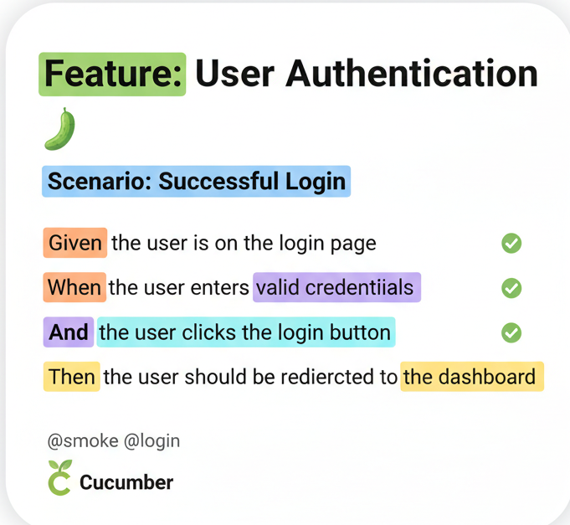
The Feature Files (BDD)
A file written in Gherkin that describes the application's functionality from the user's perspective, making it readable for all stakeholders.
Our Program contains the following Feature Files :
HomePageTestCasesFile.feature
InvalidFlowTestCasesFile.feature
LoginTestCasesFile.feature
RegistrationPageTestCases.feature
SearchPageTestCases.feature

Slide 6

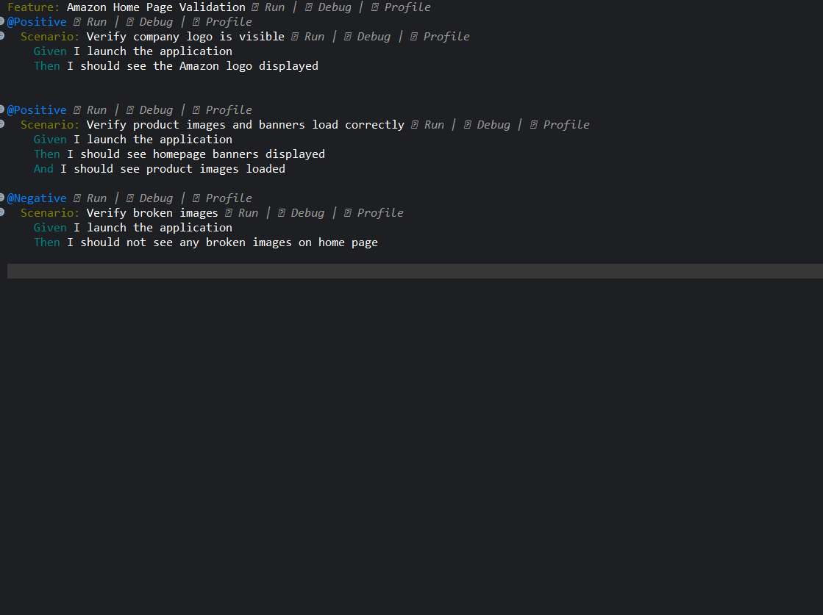
🏠 HomePageTestCaseFile.feature: This file tests the Amazon homepage by validating the visibility of the logo, the correct loading of banners and images, and ensuring no broken images are displayed.

Slide 7
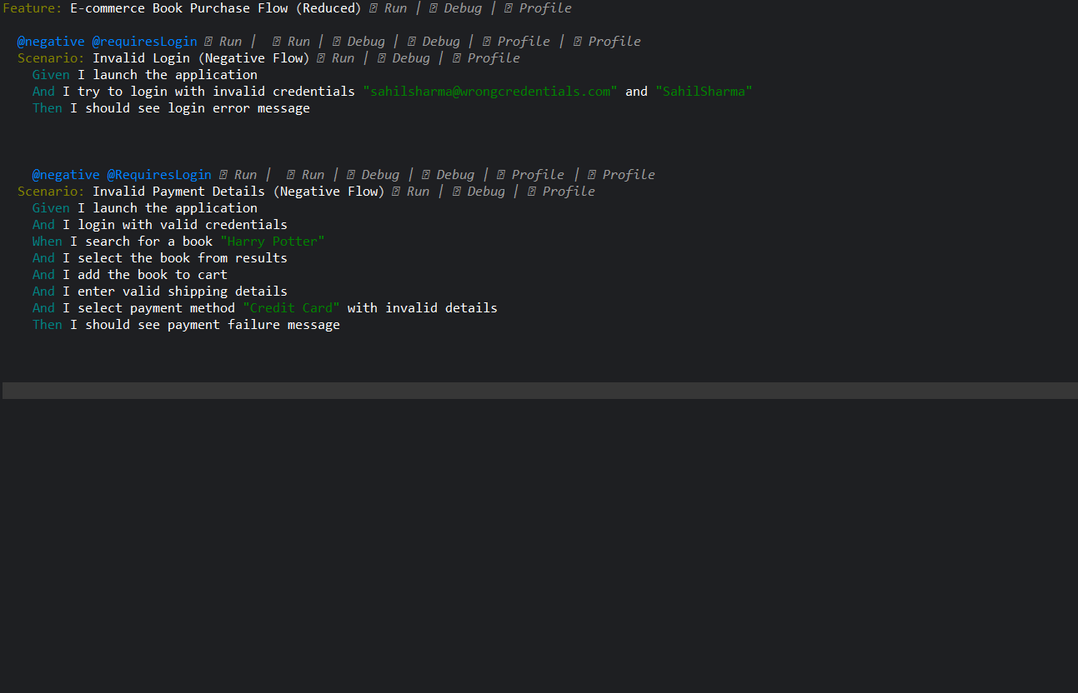
⚠️ InvalidFlowTestCaseFile.feature: This file tests the Amazon by validating login with incorrect login details and adding to cart then proceeding with wrong credit card details.

Slide 8
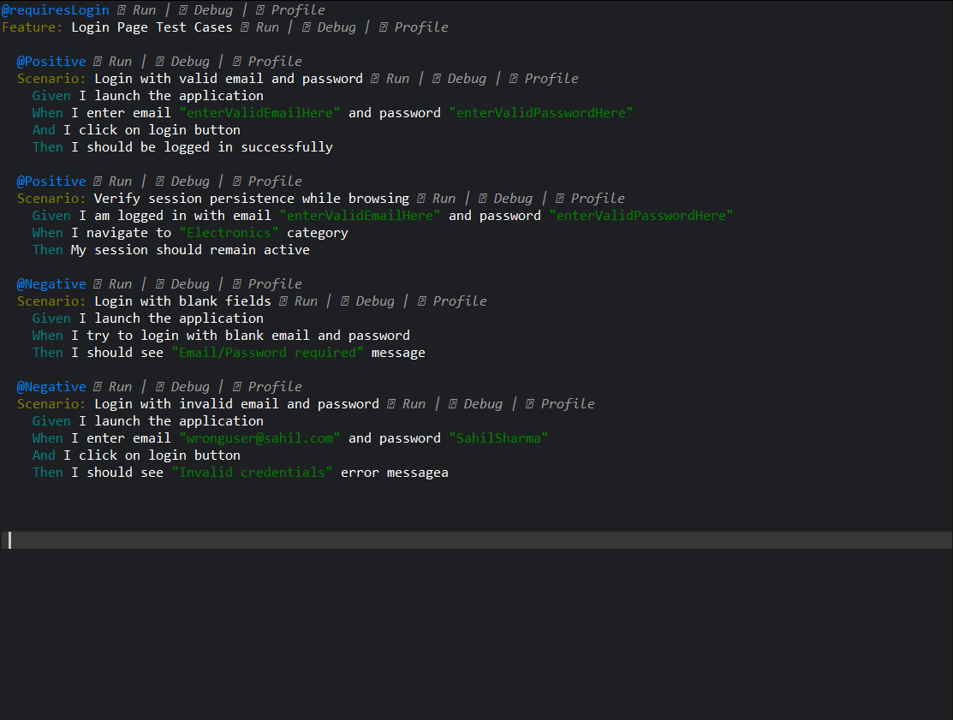
🔑 LoginTestCasesFile.feature: This file contains test cases for login functionality, including positive / negative scenarios such as invalid credentials and blank input validation.

Slide 9
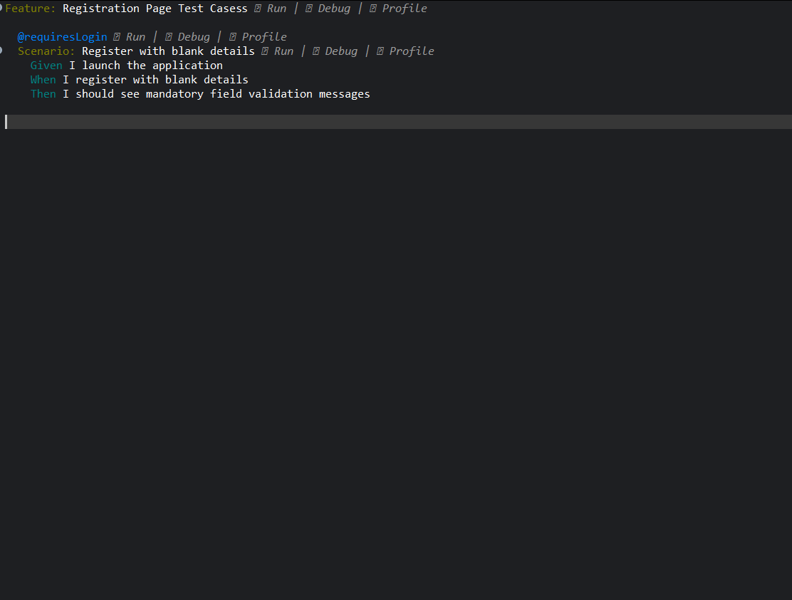
📝RegistrationPageTestCasesFile.feature: This file tests the registration page by verifying that blank input fields trigger appropriate validation messages.

Slide 10
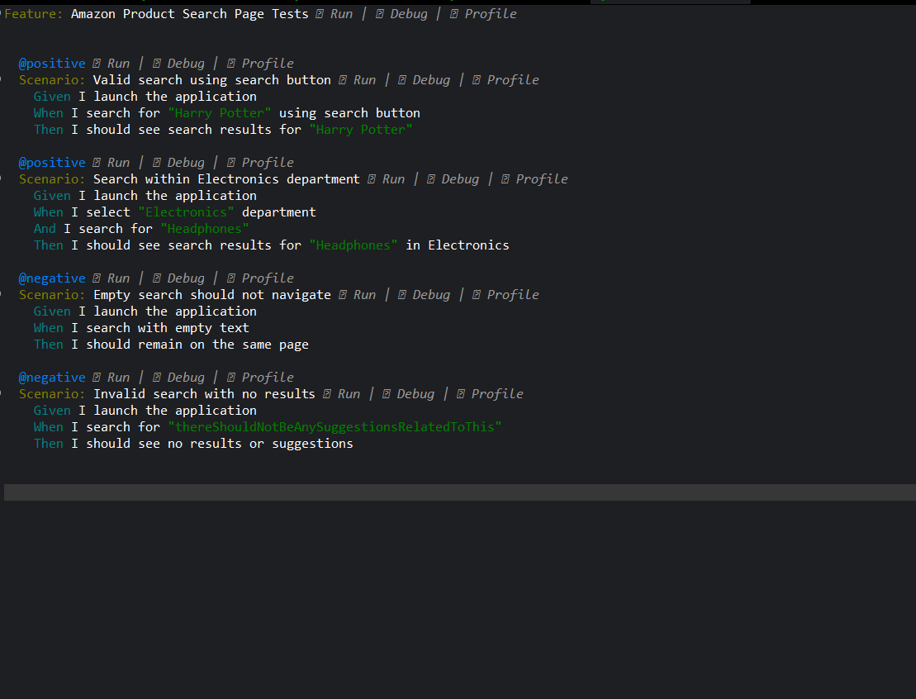
🔍 SearchPageTestCaseFile.feature: This file tests the product search functionality, including valid searches, department-specific searches, and handling of empty or invalid search queries.

Slide 11
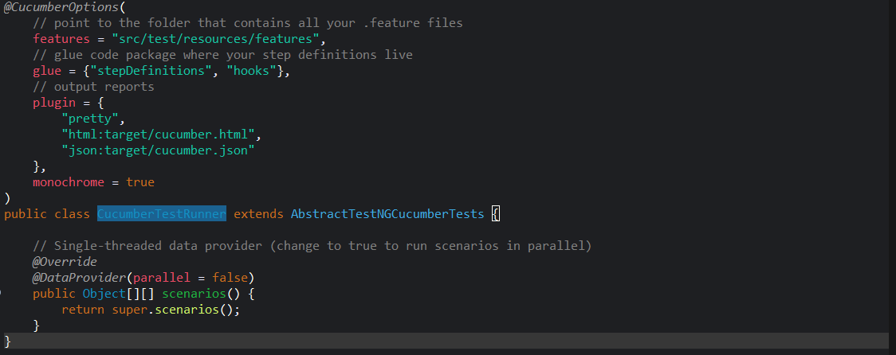
The Runner Class
runner/CucumberTestRunner.java: This class configures and executes all Cucumber test scenarios using TestNG, specifying feature file locations, step definitions, reporting plugins, and test execution settings.

Slide 12
Step Definitions
Java methods that bridge the gap between the human-readable Gherkin steps in the feature file and the actual automation code that interacts with the browser.
📚 BookPurchaseSteps.java: This class contains the step definitions for the book purchase workflow, including steps for searching, selecting, adding to cart, and verifying checkout.
🔄 CommonSteps.java: This class holds common or shared steps that are used across multiple scenarios, such as launching the application or handling session-related actions.

Slide 13

🏡 HomeSteps.java: This class implements the step definitions for validating elements on the homepage, such as the logo, banners, and product images.
🔑 LoginSteps.java: This class defines the steps for testing login functionality, including successful login, session persistence, and invalid input scenarios.
🖊️ RegistrationSteps.java: This class provides step definitions for testing user registration workflows, including validation for mandatory fields.
🔍 SearchSteps.java: This class includes step definitions for verifying search functionality, such as searching with valid and invalid inputs and filtering by department.

Slide 14
Page Object Model (POM)
A design pattern where each web page is a separate class, containing its UI element locators and the methods to interact with them. This makes the code cleaner and easier to maintain.
🏠 AmazonHomePage.java : This class represents the main landing page of Amazon, including locators and methods to interact with search bars, banners, and navigation links.
🛒 CartPage.java : This class contains elements and methods for verifying items in the shopping cart and managing cart-related actions like updating or removing products.

Slide 15
💳 CheckoutPage.java This class defines locators and interactions on the checkout page, such as reviewing order details and proceeding with payment.
🏡 HomePage.java This class represents the homepage structure with UI elements like product images, banners, and navigation components used for validation.
🔐 LoginPage.java This class encapsulates the elements and actions on the login page, such as entering credentials and handling authentication workflows.

Slide 16
💰 PaymentPage.java This class includes locators and methods for managing payment options and validating payment-related inputs during the checkout process.
📝 RegistrationPage.java This class holds the UI elements and methods related to the registration form, including field validations and form submission steps.
📊 ResultsPage.java This class manages the search results page, providing methods to interact with product listings and validate that the correct search results are displayed.

Slide 17
Reusable Utilities
Centralized helper classes with generic, reusable functions that support the entire framework, preventing code duplication.
🛠️ DriverManager.java: This utility is responsible for initializing and managing the WebDriver instance (e.g., Chrome), ensuring a single browser session is created and closed correctly.
⚙️ ConfigReader.java: This class reads configuration data, such as the application URL and browser type, from an external .properties file, making the framework more flexible.

Slide 18
Comprehensive Reporting
The framework generates multiple reports to provide a detailed view of test execution, results, and logs for effective debugging and analysis.
📝 Loggers (Log4j): Captures detailed step-by-step execution logs in the console and files, which is crucial for debugging script failures.
📄 TestNG Reports: The default HTML reports generated by TestNG that provide a quick summary of test suites, passes, and failures.
📊 Extent Reports: Creates interactive and visually appealing HTML reports that include dashboards and step-by-step test flow details.

Slide 19
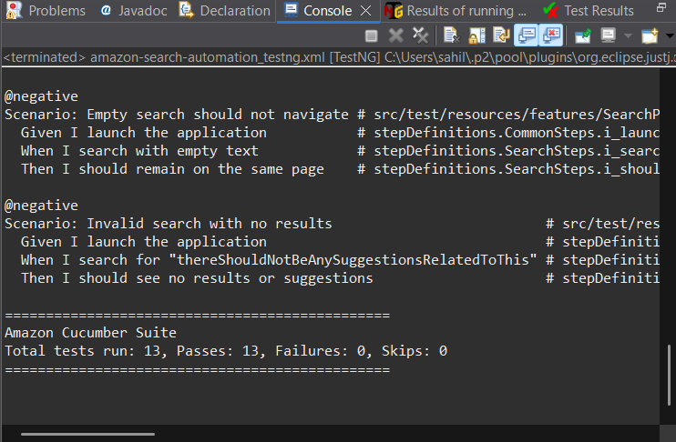
Output Logs

Slide 20
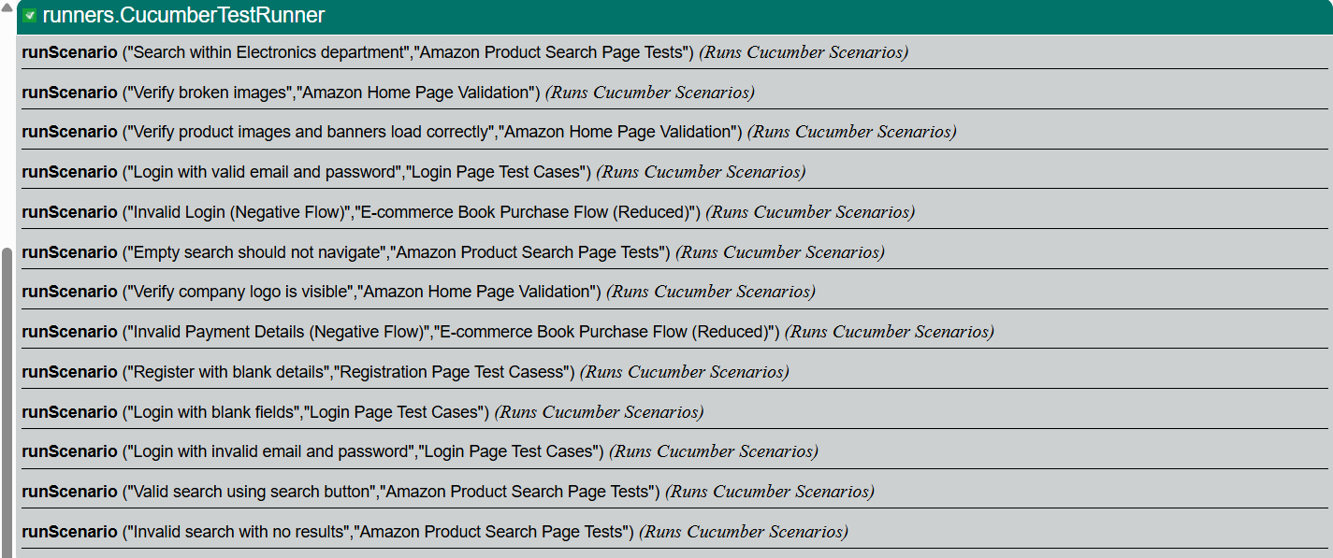
TestNG Report

Slide 21
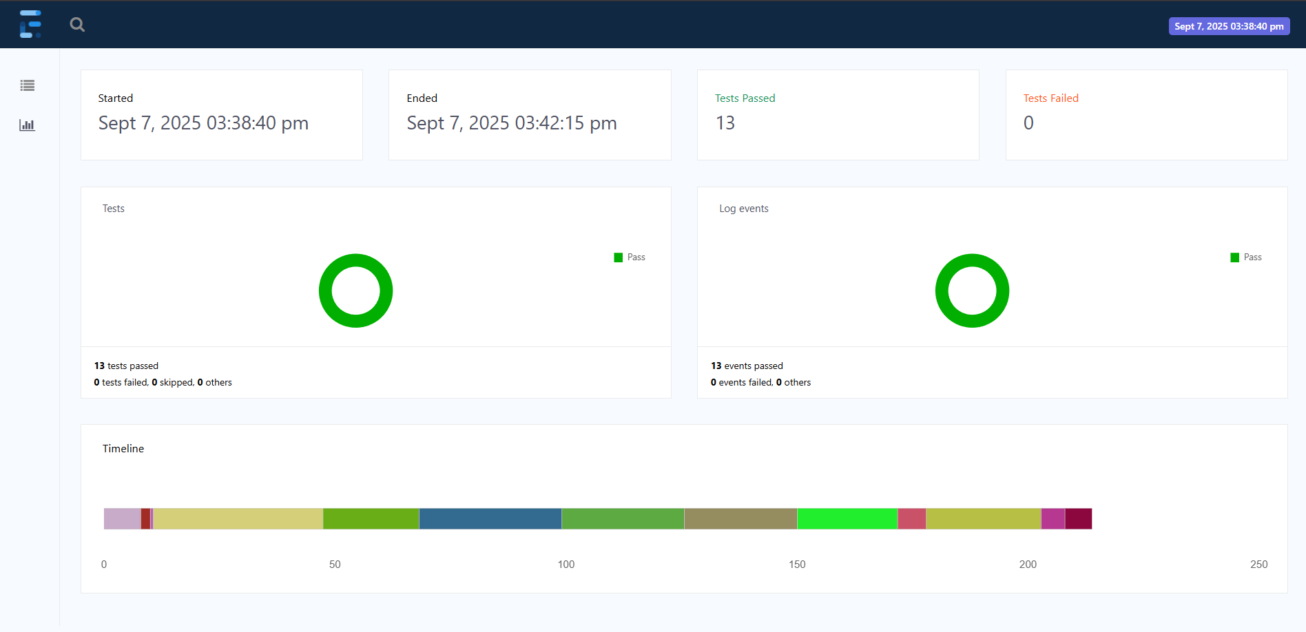
Extent Report

Slide 22
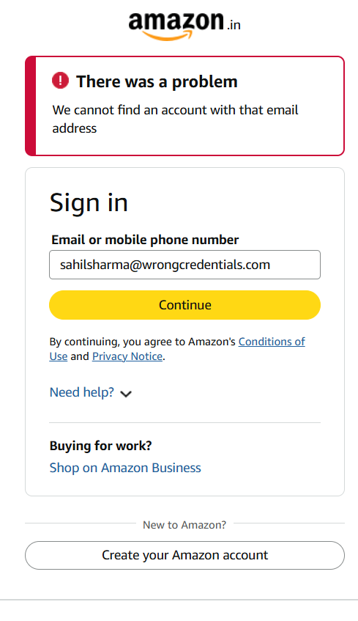
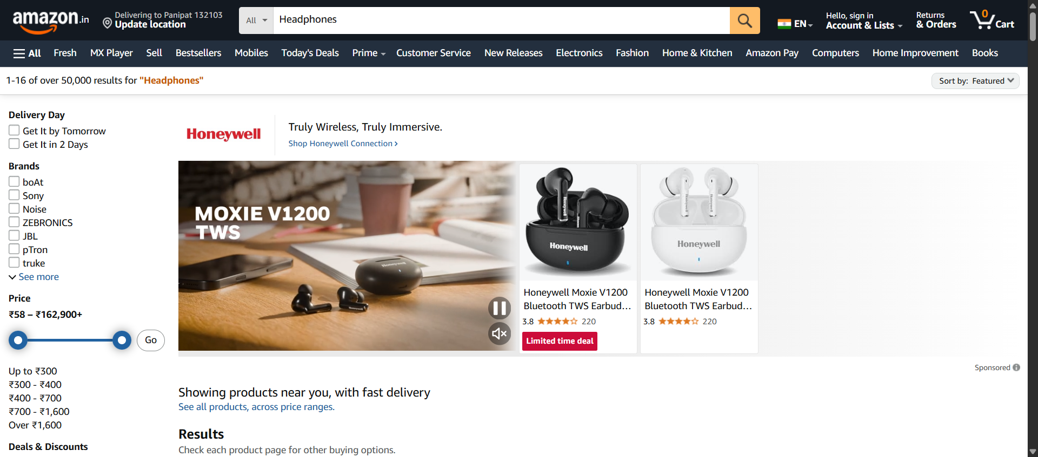
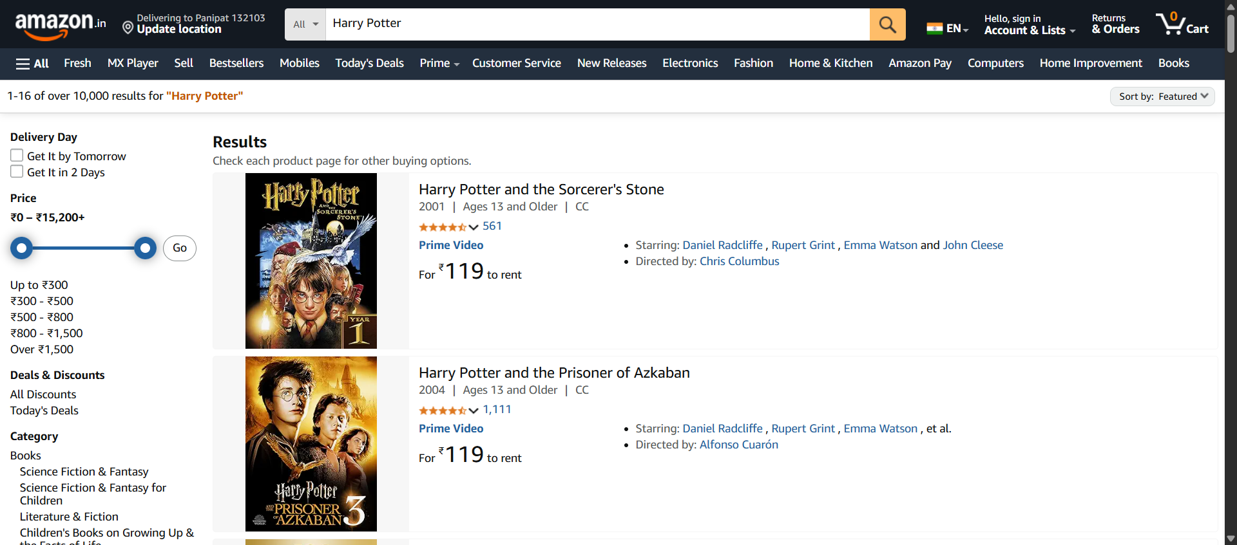
Auto Generated Screenshots

Slide 23
Conclusion & Future Scope
🎬 Conclusion
Successfully developed a hybrid automation framework that validates the Amazon purchase workflow. The framework utilizes the Page Object Model and BDD for maintainability and clarity and generates detailed reports for test analysis.
🚀 Future Scope
CI/CD Integration: Integrate the framework with a tool like Jenkins to automate test execution on every code change.
Cross-Browser Testing: Expand test execution across other browsers like Firefox and Edge using Selenium Grid.
Expand Test Coverage: Automate more scenarios, including negative test cases, payment gateways, and user account functionalities.

Slide 24

GitHub Repository
🔗 Follow this link : https://github.com/me-sahil/eCommerceCapstoneSahilSharma

Slide 25



